Slide 1


TED Talks
Recommendation
Explore the Best
Ideas You Like
Team: Junru Li, Yimin Ma, Huize Yan, Dianwen Jin
APMA4990 Intro Data Sci

Slide 2

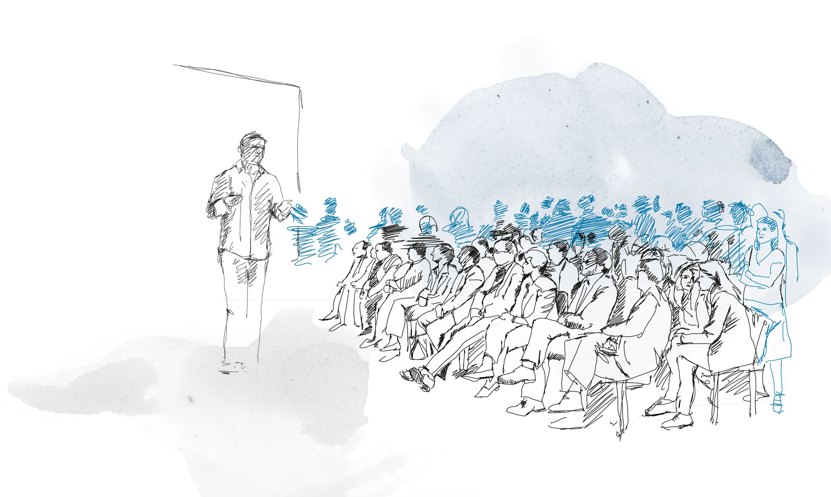
Project Goal
500+
3000+
What if I want to watch more similar TED talks but don’t want to waste time on searching?
TOPICS
TALKS
Enter a TED talk name you like
Give other recommendations
APMA4990 Intro Data Sci

Slide 3
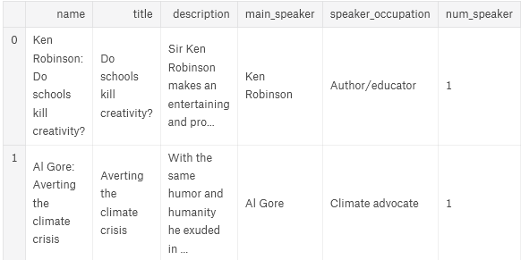
Data Source
Method 1:
Download from Kaggle: http://www.kaggle.com
Method 2:
Use spider to collect data from web.
APMA4990 Intro Data Sci

Slide 4
Method
Make a coefficient matrix containing 0 or 1, depending on the correspondence between the significance of column j and the content of TED talk i
Rows: TED titles, Columns: tags, main speakers & occupations
Select one favorite TED talk
Create a criteria to define similarity of two talks
List N talks closest to like
Select 5 top talks from the list based on a score
Finish recommendation
APMA4990 Intro Data Sci

Slide 5

Method
Select one favorite TED talk
Create a criteria to define similarity of two talks
3 criteria in the score:
“rating” “number of views” “year of release”
Score = Rating * ϕ(# of views) * ϕ(year of release), where ϕ is a gaussian function:
List N talks closest to like
Select 5 top talks from the list based on a score
Finish recommendation
APMA4990 Intro Data Sci

Slide 6

Future Improvement
Our app can predict recommendation not only from a TED talk name, but also from “Topic” ,“Speaker”.
Test with other video websites like Bilibili, Webcast platform
APMA4990 Intro Data Sci

Slide 7

Reference
https://www.kaggle.com/rounakbanik/ted-talks
https://www.kaggle.com/fabiendaniel/film-recommendation-engine
Python Machine Learning Blueprints
APMA4990 Intro Data Sci

Slide 8
Thank You
Team: Junru Li, Yimin Ma, Huize Yan, Dianwen Jin
APMA4990 Intro Data Sci

